Slide 1

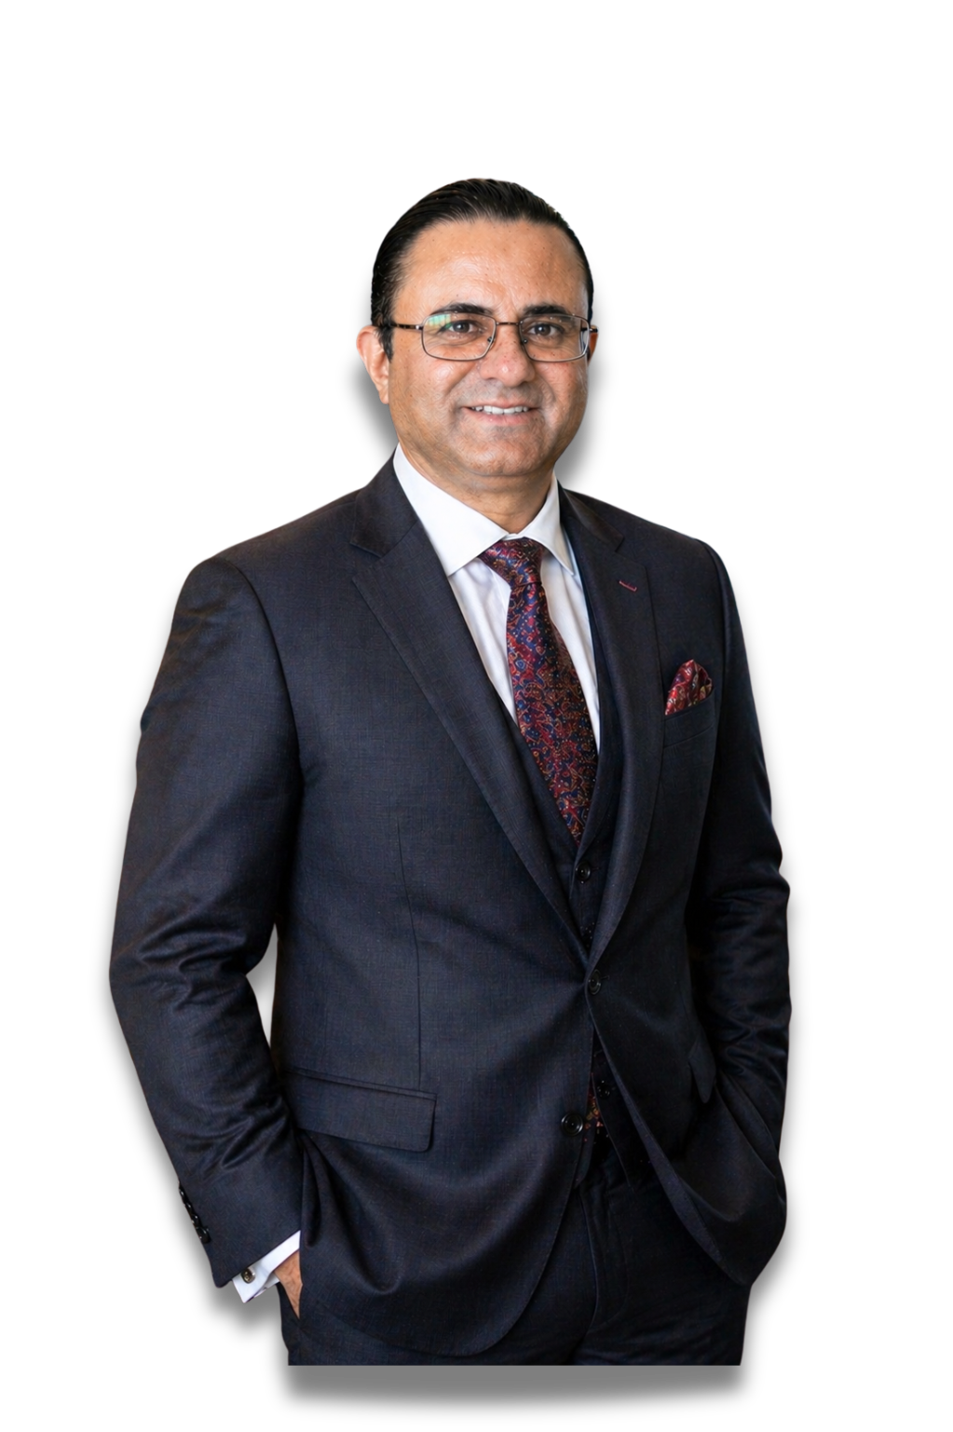

Transforming Ideas Into Action
The Consultation-First Blueprint for Predictable & High-ROAS Digital Growth
EXECUTIVE DIGITAL MARKETING MENTOR & COACH
DIGITAL MARKETING
CONSULTANT, TRAINER & MENTOR

Slide 2

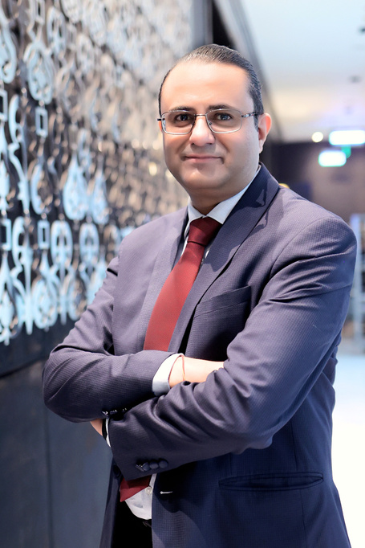
HEMANT
KUMAR SHARMA
Who is Hemant Kumar Sharma?
24+ Years Hybrid Depth
The Integrated Model
Equipped with a B.A. in Mathematics from Delhi University and an MBA in Marketing, Hemant bridges the gap between deep analytical metrics and human-centric brand positioning.
He serves as a digital growth mentor to CXOs, startup founders, and high-trust professionals across India.
Unlike traditional marketing agencies that rush into campaigns, Hemant's model mandates starting with high- clarity consulting diagnostics.
This filters out blind ad spend and ensures tactical execution (SEO, Paid Ads, Social) produces authentic revenue outcomes.

Slide 3
HEMANT
KUMAR SHARMA
The Strategic Philosophy
Strategy without execution is ineffective.
Execution without strategy is expensive.
— Hemant Kumar Sharma

Slide 4
HEMANT
KUMAR SHARMA
Option 1: Free Clarity Session
Initial Alignment Check
Operational Parameters
A quick, zero-commitment 15-20 minute online session on Zoho Meet designed strictly for first-time inquiries. Perfect for sorting out initial visual and tactical confusion, determining business viability, and seeing if Hemant's growth methods match your long-term goals.
Availability: Limited slots, scheduled strictly on fixed days (primarily Thursdays).
Focus: General review. This introductory session does not include custom strategic roadmaps, technical audits, or written post-session resources.

Slide 5
HEMANT
KUMAR SHARMA
Option 2: Fixed-Day Session
Rapid Tactical Audit
Actionable Format
An action-focused, paid 20–30 minute online consultation engineered for immediate campaign correction and troubleshooting.
Pricing: Nominal quick-access fee
(₹1,000 - 1,500 + GST).
Execution: Hosted on a fixed weekly schedule (Tuesday mornings / Saturday evenings). Designed for swift, expert answers on standard marketing issues.
Excellent for busy professionals needing expert validation of active agency campaigns, website setups, or critical marketing queries without committing to extensive retainers.

Slide 6
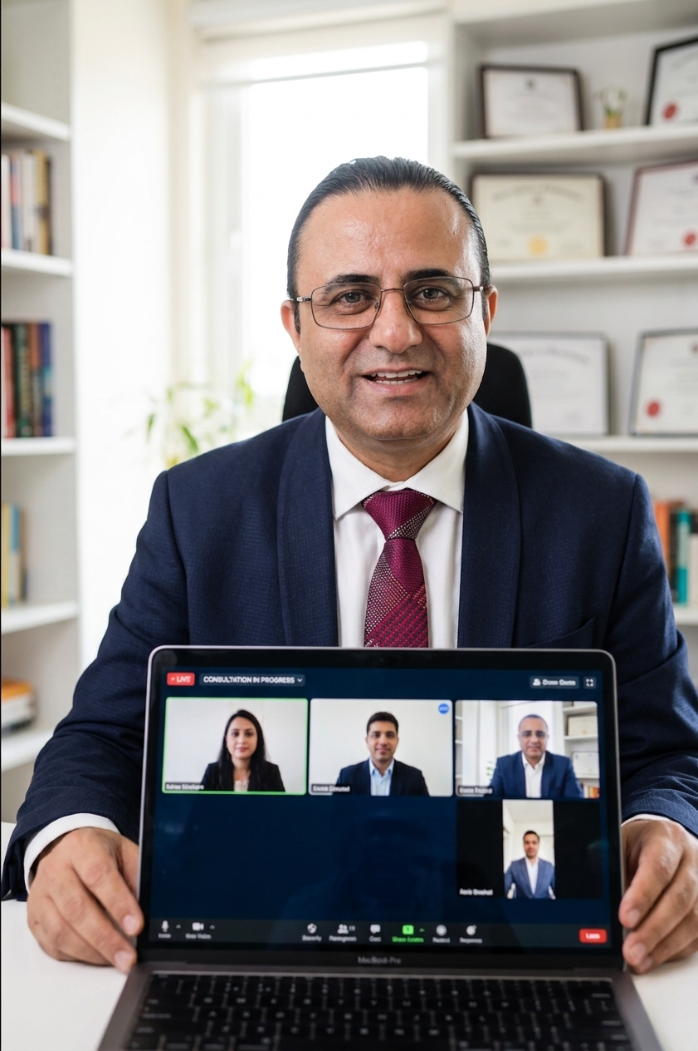
HEMANT
KUMAR SHARMA
Option 3: Online Consultation
Our Most Recommended Strategic Program
A structured, 60-70 minute online strategy session that performs a deep diagnostic of your active marketing pipeline.
It systematically identifies where your marketing campaigns are leaking money, analyzes your active competitors, and delivers a robust, concrete roadmap for sustainable client acquisition.
Includes a Custom-Compiled 48-Hour PDF Strategy Map.

Slide 7
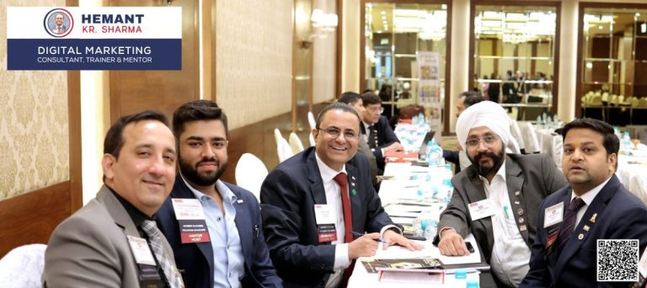
HEMANT
KUMAR SHARMA
Option 4: In-Person Premium
Executive Strategy Brain-Trust
A premium face-to-face consultation held physically in the Delhi NCR region, engineered for established business leaders and board-level executives.
Ideal for complex market entries, repositioning established products, and building structured internal team frameworks away from virtual distractions.
Includes direct strategic brainstorming, physical modeling of your funnel, and a labeled strategy layout.

Slide 8
HEMANT
KUMAR SHARMA
Flagship Spotlight: Option 3
A detailed view of the Online Strategic Consultation Blueprint

Slide 9



HEMANT
KUMAR SHARMA
Option 3: Consultation Process
Mandatory Pre-Session Questionnaire: To protect the call's value, you submit detailed information about your business, marketing assets, and current roadblocks beforehand.
70-Minute Live Diagnostics: Hemant reviews your digital presence in real time, uncovering performance blocks, technical faults, and conversion leaks.
Funnel Restructuring Map: Aligning your branding with target customer profiles to hook high-ticket clients in under 8 seconds.
Atomic Growth Alignment: Structuring minor, compounding 1% website corrections that build long-term, high-converting organic results.

Slide 10


HEMANT
KUMAR SHARMA
The Custom 48-Hr PDF Strategy Map
1. Ecosystem Audit
2. Competitor Intel
3. Action Plan
A comprehensive assessment highlighting landing page errors, pixel/tracking issues, and copy mismatches on your platforms.
A deep review of competitor traffic sources, active keyword footprints, and backlink strategies to locate quick traffic gaps.
A concrete, timeline-based quarterly execution roadmap indicating clear priorities to maximize lead capture and ROAS.

Slide 11

HEMANT
KUMAR SHARMA
Why Option 3 is Recommended
The Perfect Blend of Value & Depth
Option 3 provides business owners, founders, and consultants with an executive-level strategic blueprint without requiring long-term agency commitments.
By diagnosing conversion blocks and auditing competitors prior to campaign launches, it consistently protects budgets and prevents expensive marketing errors from occurring.

Slide 12



HEMANT
KUMAR SHARMA
From Ideas to Action
Choose the consultation model that matches your immediate goal.
Hemant Kumar Sharma
Digital Marketing Consultant | Trainer | Mentor
Delhi NCR Location
Strategic Support
Direct Connections
Northex Mall, Sector 9, Rohini, New Delhi 110085
hello@hemant.co.in
+91 98116 81687
www.hemant.co.in

